Slide 1


Citi Bike Data Science In New York City Minjae Lee 11/09/2020

Slide 2

Citi Bike Operation
Bike/Scooter sharing is a new p2p consumer business model
Dockstation version in US
12000 citibikes, more than 750 dock stations in NYC
Operated by motivate, gains monopoly to operate shared-bikes in NYC
1. Individual → Subscriber, Customer
2. Corporate

Slide 3
Data
Citi Bike Monthly Trip Data
- Trip data including trip duration, Bike ID,
start and end time, start and end locations,
user type, gender, age
- 5% of each month data
NYC Weather Daily Data
- Temperature, precipitation, snow
Period of Data
- September 2019 ~ August 2020
Data
- 12.6 million data and 22 features

Slide 4
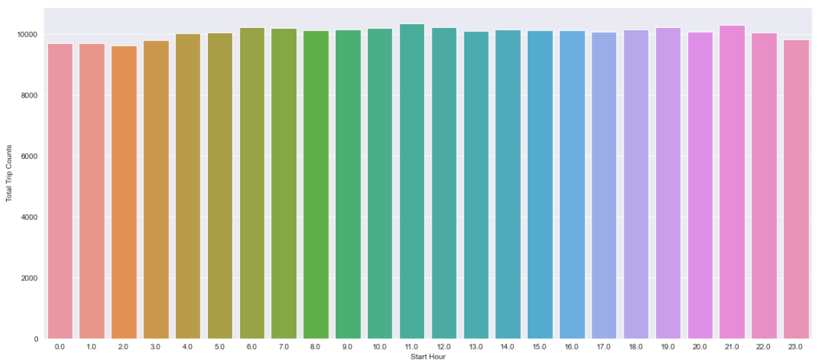
Hourly Trip Count

Slide 5
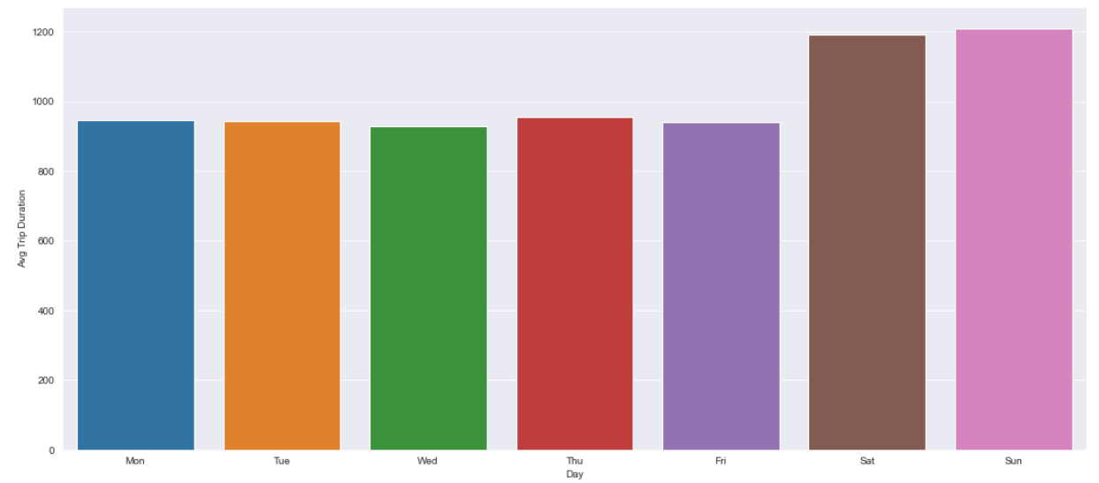
Daily Average Trip Duration

Slide 6
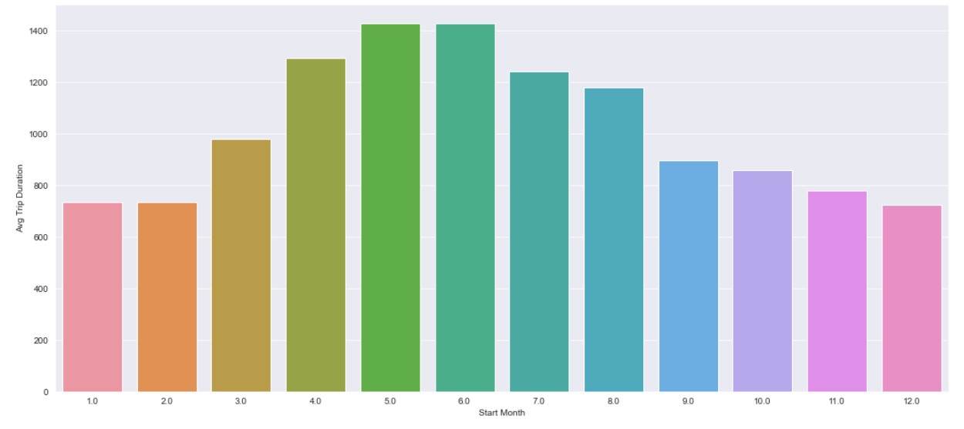
Monthly Average Trip Duration

Slide 7
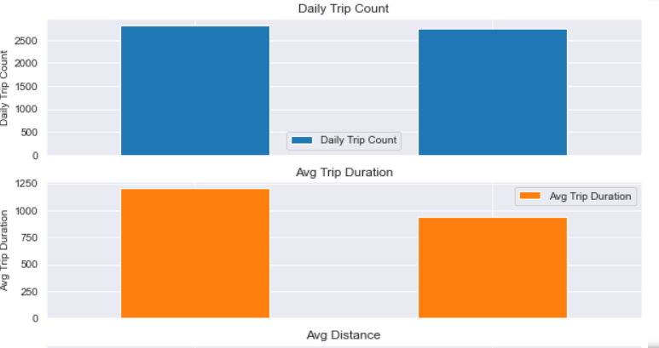
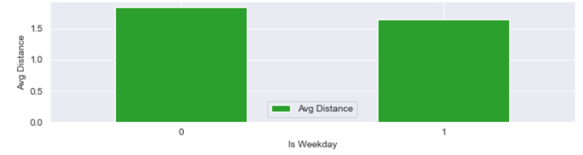
Trip count, distance, duration in weekends are more than weekdays
0 : Weekends, 1 : weekdays

Slide 8
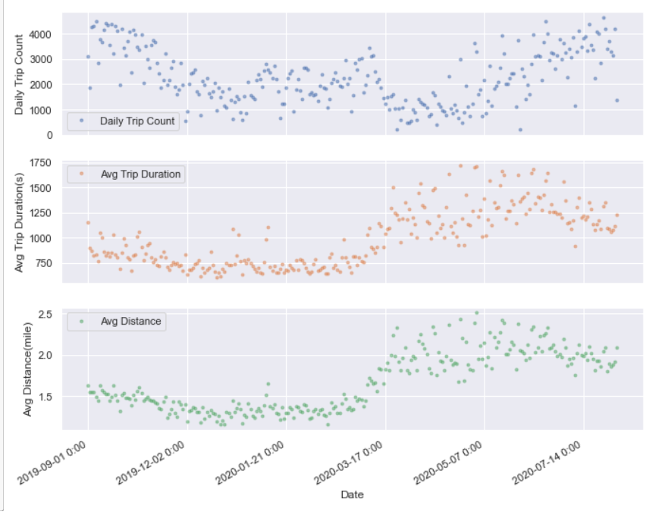
Seasonal Trend of Citi Bike Trips

Slide 9
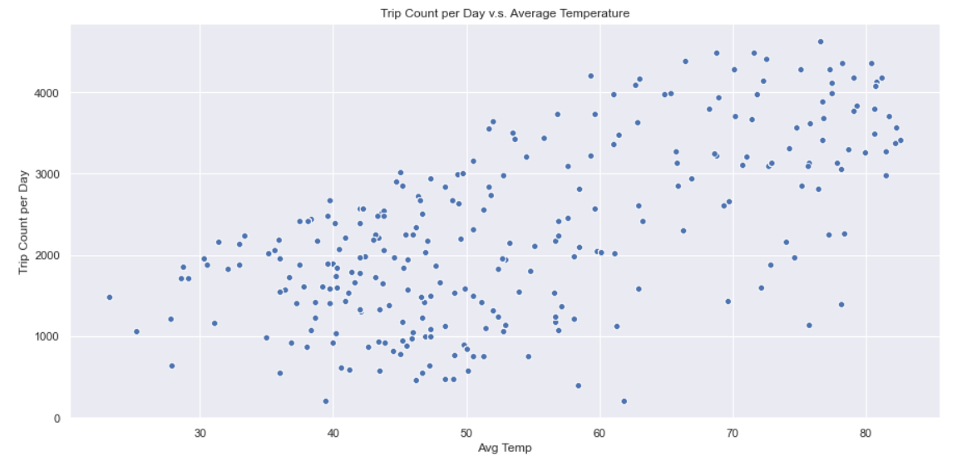
Temperature impact by ride counts

Slide 10
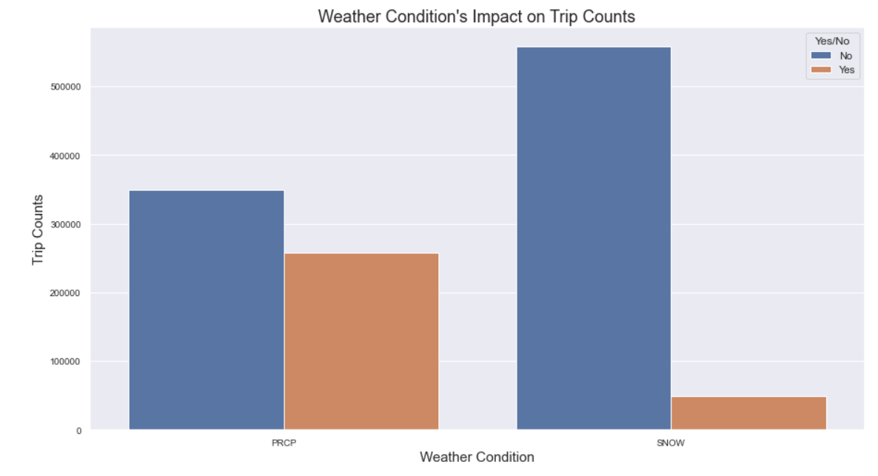
Weather Conditions impact by Ride Counts

Slide 11
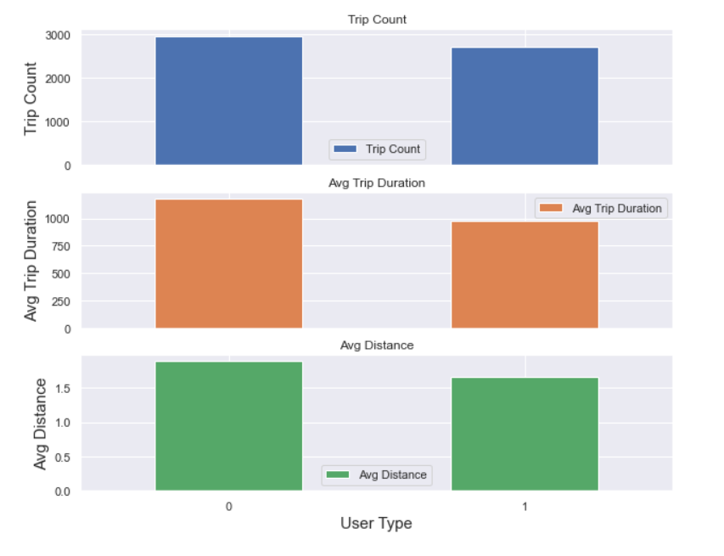
Ride by User Type
0 = Subscriber
1 = Customer

Slide 12
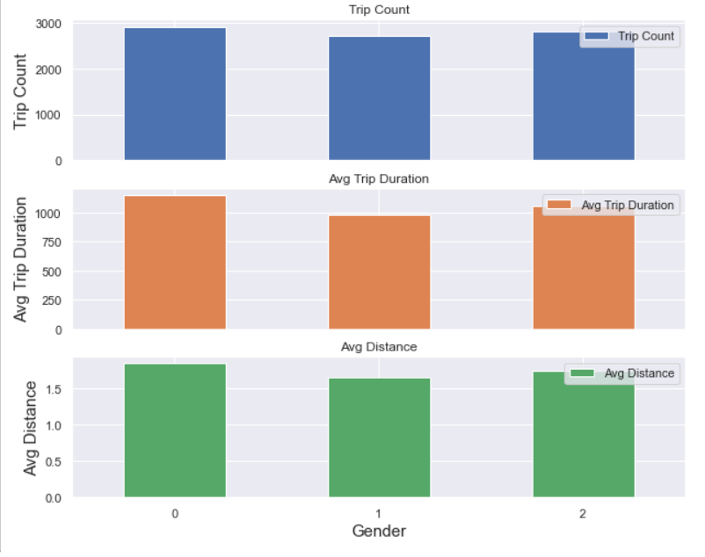
Ride by Gender
0=unknown;
1=male;
2=female

Slide 13
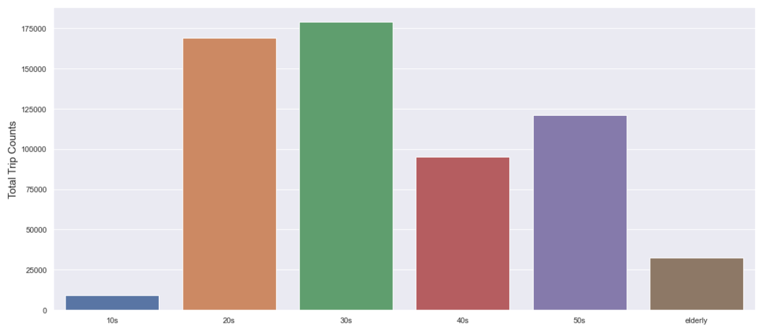
Ride by Ages

Slide 14
Target Variable
• start station checkout counts
Multiple Linear Regression, Ridge
• Model Accuracy: 77.97 % on test data

Slide 15
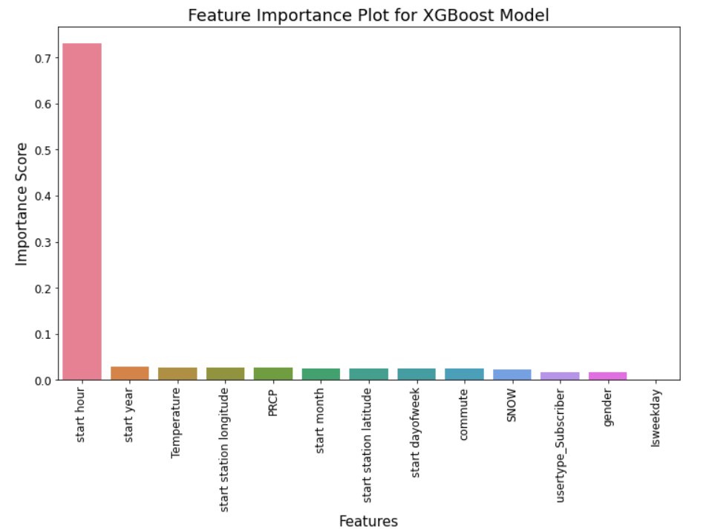
•Feature Importance
Start hour is excessively biased
• Test data 82.4 %

Slide 16
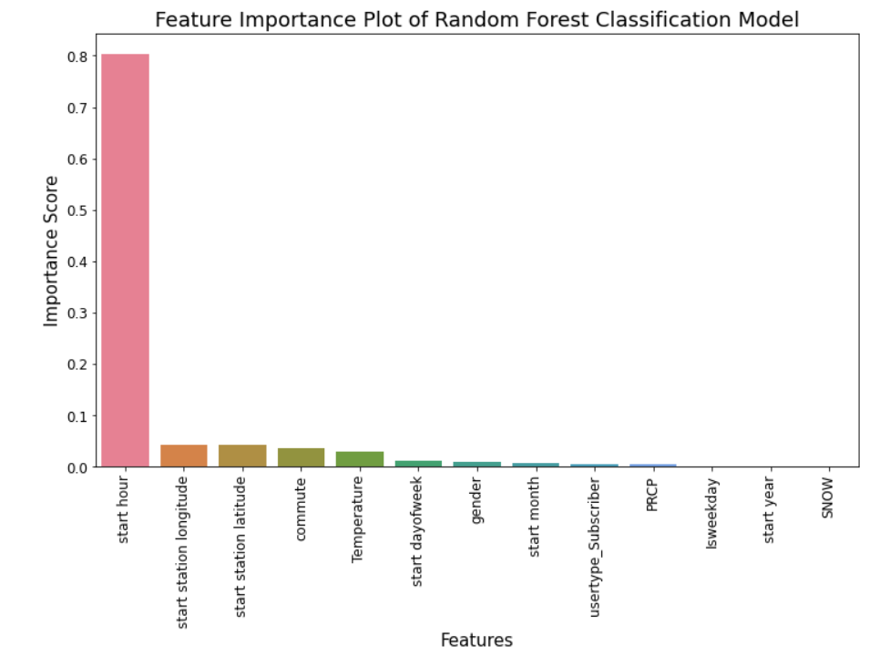
•Feature Importance
Start hour is excessively biased as well
Test data 84.0 %

Slide 17
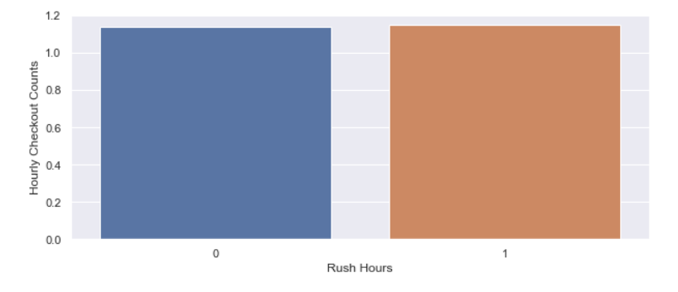
Rush Hours effect on Target Variable
[7, 8, 9, 16, 17, 18]

Slide 18
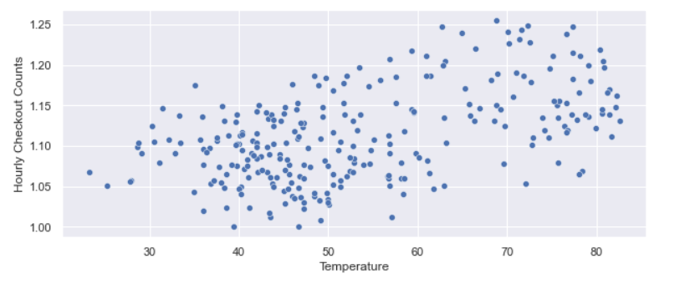
Temperature effect on
Target Variable

